Slide 1
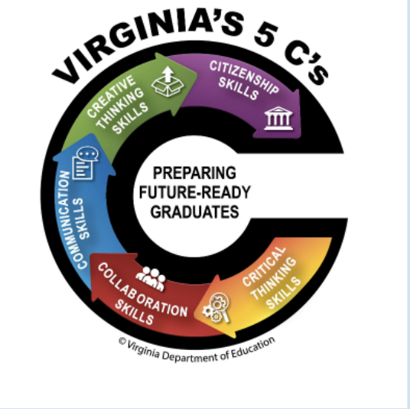

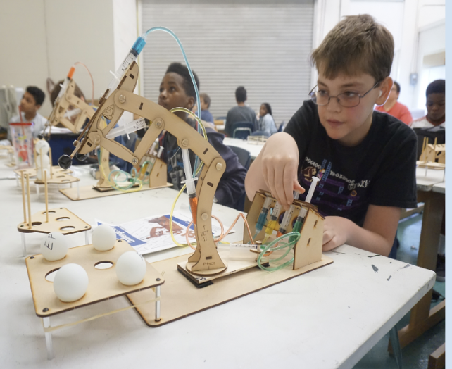
SUFFOLK PUBLIC SCHOOLS
Turlington Woods School
School Performance Plan
2024-2025
#SPSCREATESACHIEVERS

Slide 2
Domain I:
Academics
High Quality Instructional Materials, High-Quality Instructional Routines, High-Quality Prioritized Placement
#SPSCREATESACHIEVERS

Slide 3
Academics
SMART Goal: By the end of the 2024-2025 school year, students entering Turlington Woods will improve their grades by at least one letter grade in all content areas through targeted interventions and support, ensuring enhanced academic success across all subjects.
Evidence-based Intervention: Differentiated Instruction: Teachers will incorporate targeted remediation and instruction into their daily classroom practices (Tier 1 instructional strategies).
Student Measures:
Assessment Performance: Formative and summative assessments will be used to guide instruction and identify increase in scores.
Grade Improvement Tracking:Targeted walkthrough to gauge student understanding and the percentage of students who achieve an increase of at least one letter grade in each content area by the end of the 2024-2025 school year.
#SPSCREATESACHIEVERS

Slide 4
Academics
Staff Measures:
Lesson plans will reflect effective use of Tier 1 instructional strategies.
Grade Improvement Tracking:Targeted walkthrough to gauge student understanding and the percentage of students who achieve an increase of at least one letter grade in each content area by the end of the 2024-2025 school year.
Alignment to the Strategic Plan: GOAL 2: Create a dynamic learning environment that promotes high student achievement, stimulates student engagement, supports staff creativity, ensures school safety, and reinforces positive staff and student relationships.
#SPSCREATESACHIEVERS

Slide 5
Domain II
Staffing Supports
Teacher Recruitment, Prioritized Placement
#SPSCREATESACHIEVERS

Slide 6
Staffing Supports
SMART Goal: Increase teacher retention rates by 10% compared to the previous school year by implementing targeted support programs and initiatives focused on mentorship, professional development, and student and staff wellness, thereby fostering a stable and positive school culture and climate by the end of the 2024-2025 academic year.
Evidence-based Intervention: Best practices in K-12 HR
Student Measures:
Track and compare data on student disciplinary incidents, such as suspensions, detentions, and behavioral referrals, before and after implementing support programs to evaluate any changes in student behavior.
Increase student attendance rates throughout the school year, correlating with a supportive school culture and positive teacher retention, by monitoring attendance data and identifying improvements by the end of the academic year.
#SPSCREATESACHIEVERS

Slide 7
Staffing Supports
Staff Measures:
Building level administration will monitor staff participation in mentorship programs, professional development workshops, and wellness activities to gauge the level of engagement and utilization of available support resources at the building level.
Track the number of teachers who remain at the school throughout the academic year and compare it to previous years to measure the impact of implemented support programs on teacher retention.
Alignment to the Strategic Plan: Goal 3 - Ensure the effective and efficient management of capital and human resources.
#SPSCREATESACHIEVERS

Slide 8
Domain III
Professional Learning Supports
Logistical & Operational, Instructional Support Cycles,
Career Development
#SPSCREATESACHIEVERS

Slide 9
Professional Learning
SMART Goal: During the 2024-2025 school year, professional development will focus on PBIS strategies that engage students and staff while incorporating Tier 1 and Tier 2 interventions into our already utilized programs.
Evidence-based Intervention: Positive Behavior Intervention Strategies
Student Measures:
Behavioral Incident Reduction: Decrease unwanted student behaviors due to targeted supports
Student Engagement Surveys: Improvement in student engagement levels, as measured by bi-annual student surveys that assess their perception of the school climate, engagement in learning, and sense of belonging.
#SPSCREATESACHIEVERS

Slide 10
Professional Learning
Staff Measures:
PBIS Strategy Implementation: Increased staff engagement in PBIS due to provided staff development.
Teacher Confidence and Competence: Improvement in teachers' self-reported confidence and competence in using PBIS strategies, as measured by pre- and post-professional development surveys.
Alignment to the Strategic Plan: GOAL 2: Create a dynamic learning environment that promotes high student achievement, stimulates student engagement, supports staff creativity, ensures school safety, and reinforces positive staff and student relationships.
#SPSCREATESACHIEVERS

Slide 11
Domain IV
School Climate Supports
#SPSCREATESACHIEVERS

Slide 12
School Climate Supports
SMART Goal: By the end of the 2024-2025 school year, Turlington Woods will decrease office discipline referrals by 10% across the school through the consistent implementation of Positive Behavior Interventions and Supports (PBIS) strategies, targeted professional development for staff, and regular data monitoring, ensuring a more positive and supportive school environment.
Evidence-based Intervention: Active Supervision
Student Measures:
The percentage decrease in the total number of office discipline referrals (ODRs) recorded throughout the 2024-2025 school year compared to the previous year.
Improvement in student-reported perceptions of school safety, behavior expectations, and overall school climate, as measured by bi-annual surveys.
#SPSCREATESACHIEVERS

Slide 13
School Climate Supports
Staff Measures:
The percentage of teachers who consistently implement PBIS strategies and interventions, as observed during classroom walk-throughs and documented in fidelity checklists.
The number of professional development sessions attended by teachers focused on PBIS and behavior management, coupled with evidence of applying these strategies in their classrooms, as reported in follow-up surveys or classroom observations.
Alignment to the Strategic Plan: GOAL 2: Create a dynamic learning environment that promotes high student achievement, stimulates student engagement, supports staff creativity, ensures school safety, and reinforces positive staff and student relationships.
#SPSCREATESACHIEVERS

